Slide 1


Slide 2

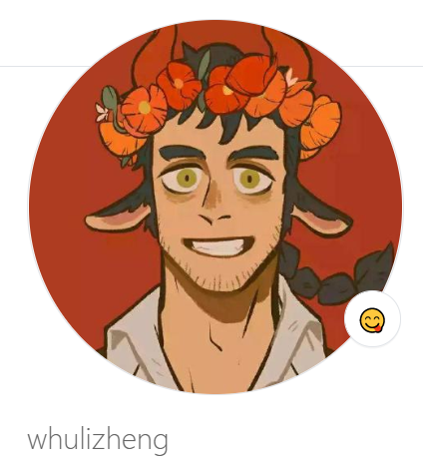
我的GitHub主页

Slide 3
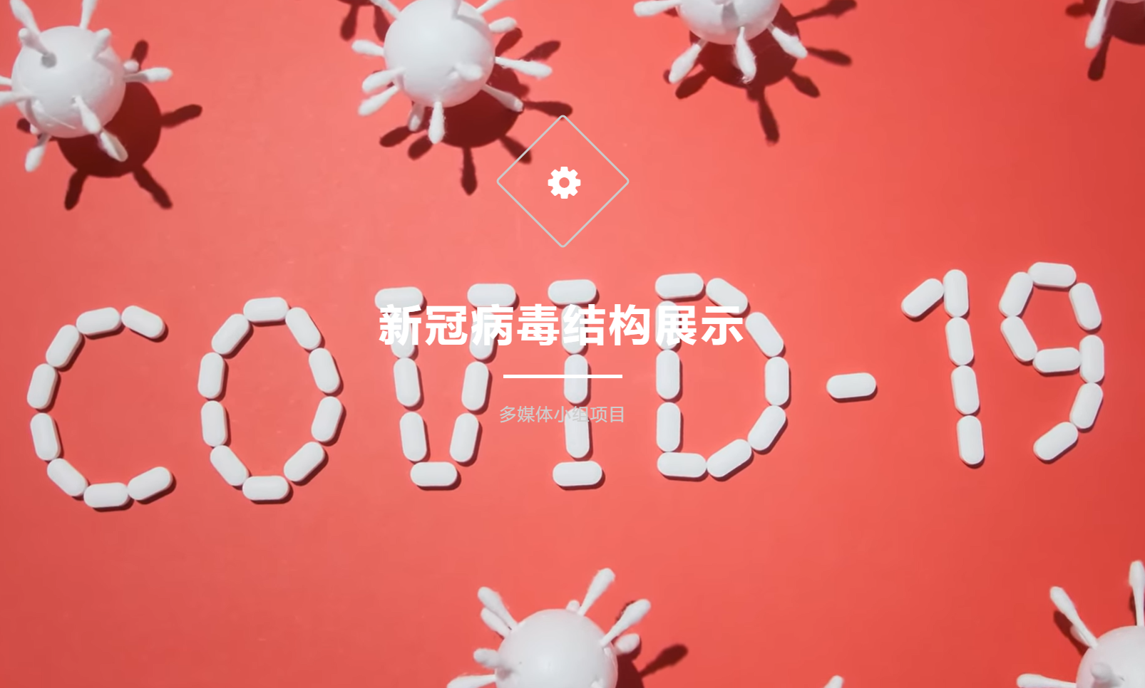

Slide 4

coming soon
……

Slide 5
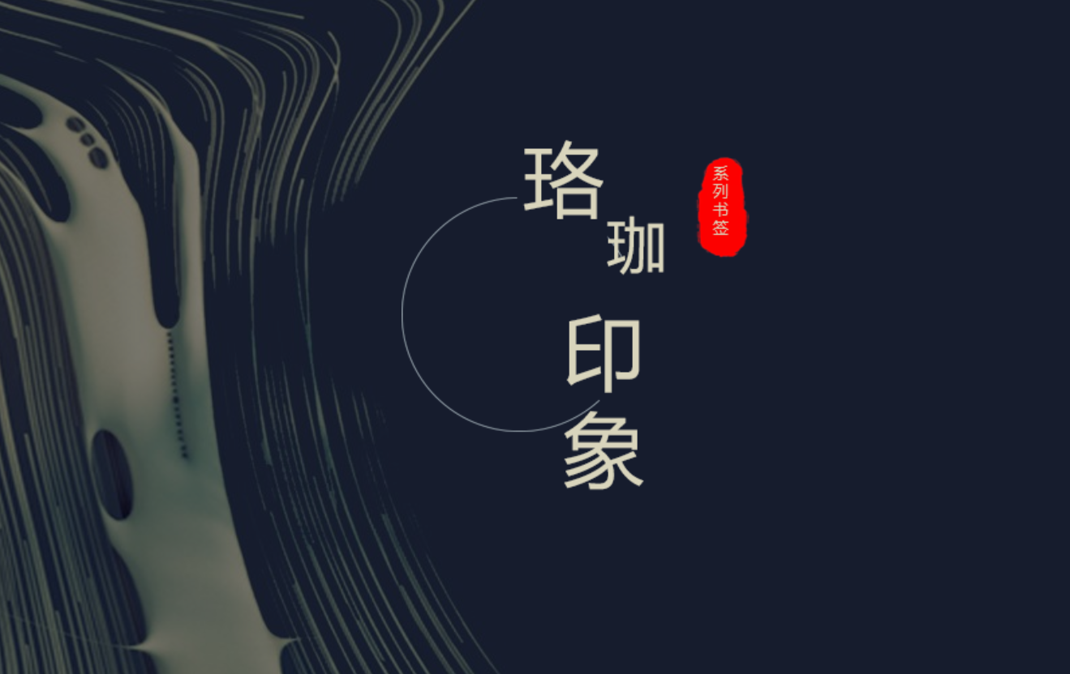

Slide 6


Slide 7


Slide 8
paper
TSA-GAN:
A Robust Generative Adversarial
Networks for Time Series Augmentation

